Slide 1
DOGS THAT CHANGED SOCIETY
Notes:
**Note: This is a multi day lesson. **Teachers- review slides prior to the lesson to review teacher notes.
Students will be researching several historic dog figures that changed society and will create educational podcasts to showcase the information to listeners.

Slide 2
In this lesson students will research several historic dog figures that changed society forever and will create educational podcasts to showcase the information to listeners.
National Curriculum Standards for Social Studies Theme 2: Time, Continuity, and Change
CCSS.ELA-LITERACY.SL.9-10.4
CCSS.ELA-LITERACY.SL.9-10.5

Slide 3
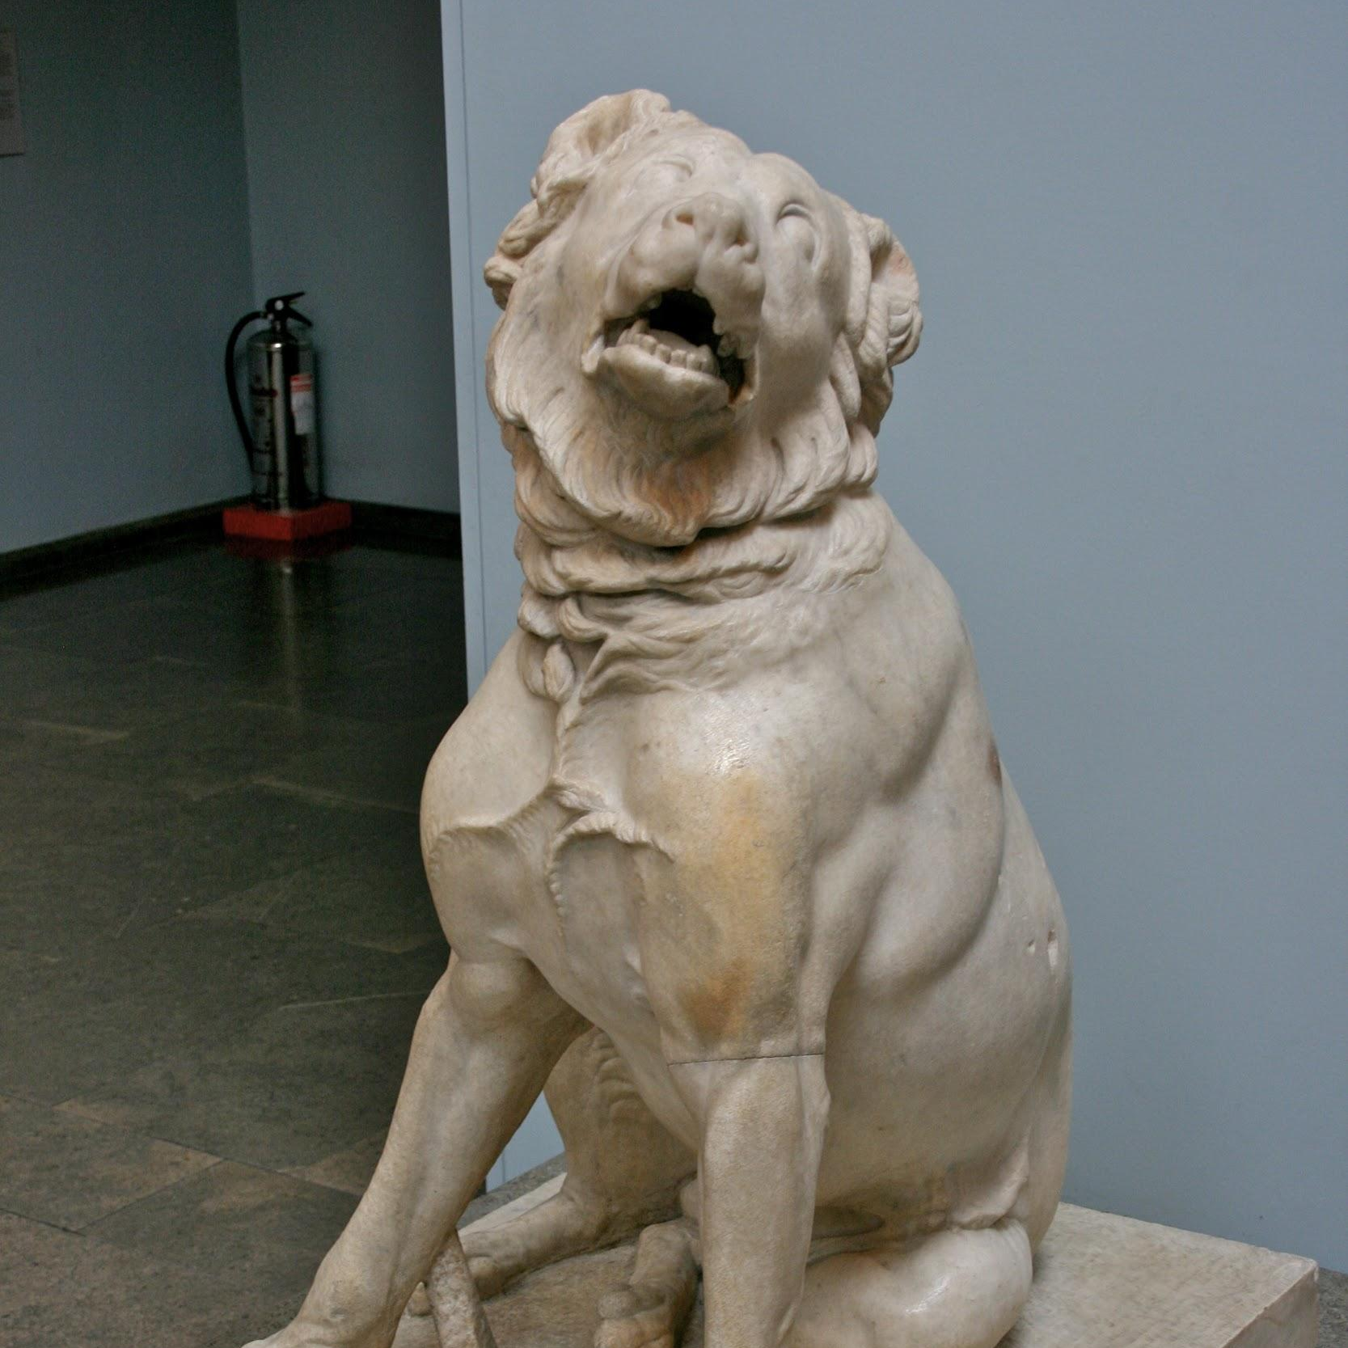
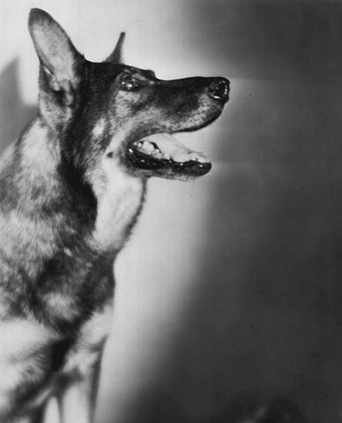
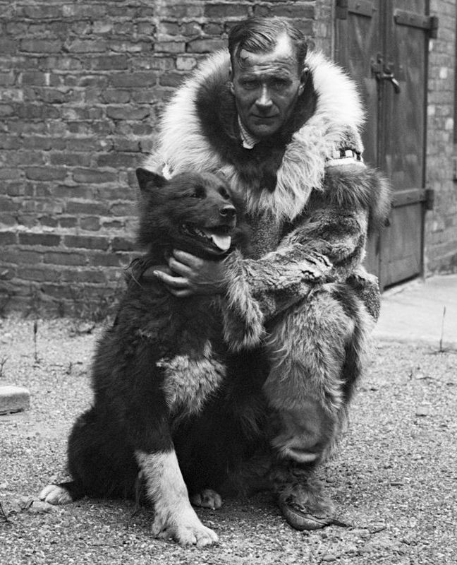
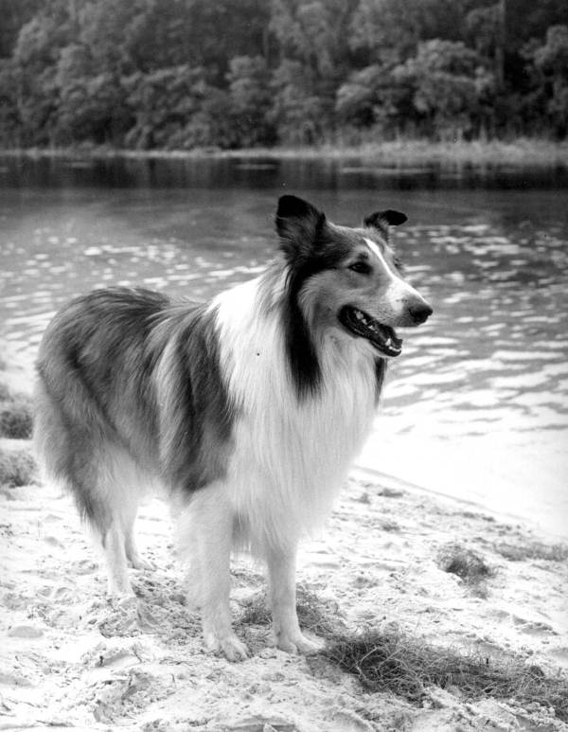
Think-Pair-Share
Lesson 1
Can you name some historic or famous dogs from the past, or present day?
Notes:
Invite students to discuss in pairs historic dogs they may be familiar with. *3 dog picture clues will appear on click to guide students. Discuss as a class on the next slide.

Slide 4
HISTORIC/FAMOUS DOGS YOU MAY BE FAMILIAR WITH
Lesson 1
Rin Tin Tin
The history of this canine goes back to the first world war, when, Lee Duncan, an American soldier, who in a military kennel that had been bombed, found a of German Shepherd mother and her two puppies, which he picked up to then name them Rin Tin Tin and Nanette.
Balto
This amazing dog is considered a hero, because thanks to him, thousands of lives were saved. Balto was a Siberian Husky ​​who lived in a small Alaskan town called Nome and was used to pull sleds.
Lassie
Also known as "the most famous dog in the world", this iconic twentieth-century fiction character was part of great films and TV series. Lassie was created in the story written by Briton Eric Knight, "Lassie come home".
Notes:
Students may mention these dogs, among others. Explain that on the next slide, students will be watching a video about 10 Famous Dogs Who Changed History (7min). While watching the video, instruct students to write down 2-3 historic dogs that they might be interested in learning more about.

Slide 5
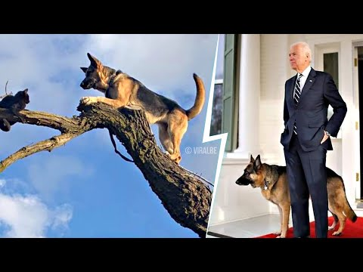
“TEN FAMOUS DOGS WHO CHANGED HISTORY”
While watching the video, write down 2-3 historic dogs you might be interested in learning more about.
Lesson 1
Notes:
Ten Famous Dogs Who Changed History YouTube video
Additional Resources:
Ten dogs that changed the world - CNN.com
4 Dogs Who Changed History – American Kennel Club (akc.org)

Slide 6
Soon you will be researching a historic dog and creating a podcast episode to share your research.
Podcasts are used to present information and educate listeners
Lesson 1
What examples of podcasts do you know about or listen to?

Slide 7
Let’s listen to some podcasts.
Pay attention to the structure of the podcasts and the techniques the hosts use.
Lesson 1
The Haunting Effects of Going Days Without Sleep
Click the megaphone to listen.
Brain Traps
Click the megaphone to listen.
Notes:
Have students listen to 5-minute segments of both podcasts, “Brain Traps” and “The Haunting Effects of Going Days Without Sleep.” Ask students to pay attention to the structure of each podcast and the devices/techniques that the hosts use.

Slide 8
PODCAST STRUCTURE
Lesson 1
LESSON 1 WRAP UP
What did you notice about the techniques used in the podcast samples we listened to?
Notes:
Have students brainstorm as a class about what is included in the podcasts (different voices, sounds, music, interviews, presenting information in a fun and relatable way, etc.). Explain that in the next lesson, students will begin researching and creating their podcasts.

Slide 9
DOGS THAT CHANGED SOCIETY
Lesson 2
In the previous lesson we learned about a few dogs that impacted history.
Let’s review some of them…
Rin Tin Tin
the Newfoundland that saved Napoleon
Nixon’s cocker spaniel, Checkers
Charlie, the Welsh Terrier from the Cuban Missile Crisis
Robert the Bruce’s Bloodhound
Notes:
**Prior to this lesson- review and print the Create Your Own Podcast Directions and print for students.
Invite students to share other dogs they remember from the previous lesson.

Slide 10
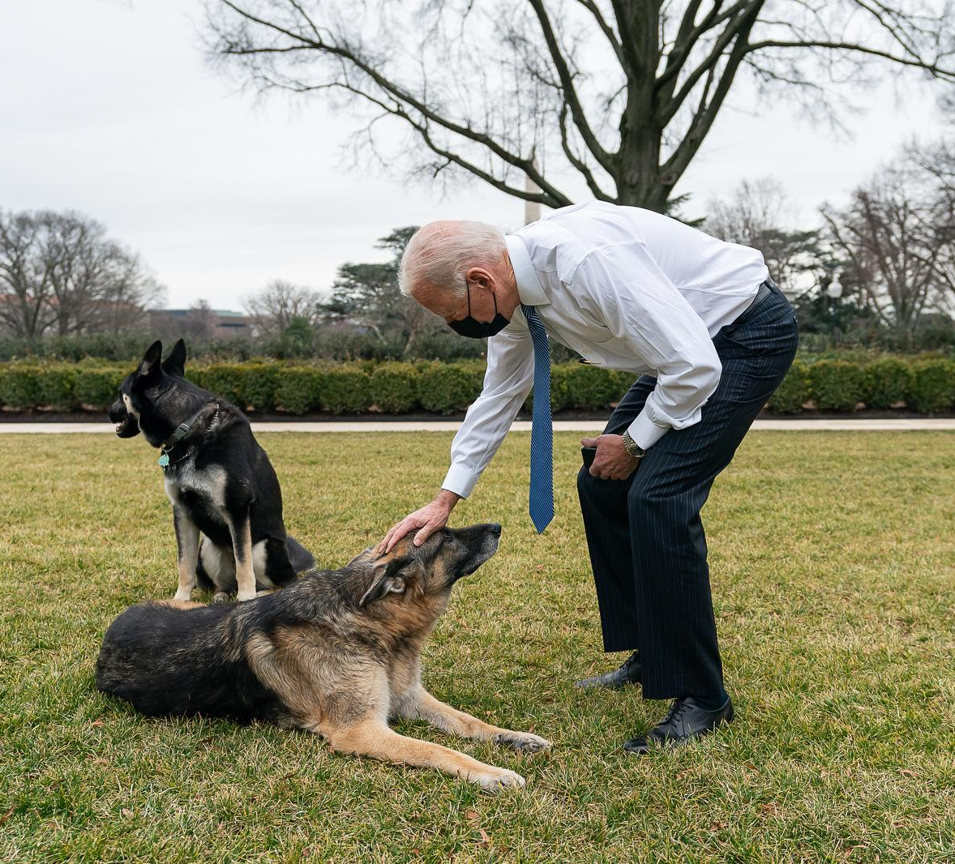
CREATE YOUR OWN PODCAST
Lesson 2
In small groups of 2-4, you will research a historic dog that changed society and you will create your own podcast to share what you’ve learned.
Create Your Own Podcast Directions
Begin research.
Then, carefully plan out your podcast.
Finally, find a quiet spot to record your podcast.
Notes:
Teachers can assign a historic dog to each group or you can allow students to pull names from a hat.
Review the Directions page as a class
Students may need 1-2 class periods to research and record their podcasts. Afterwards, students can share in class or on a class website.

Slide 11
CREDITS
Special thanks to all the people who made and released these awesome resources for free:
Presentation template by SlidesCarnival

